Slide 1
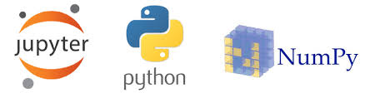
Python for Physics
Rabia Tabassum
Assistant Professor

Slide 2
Key topics Covered
Introduction to Jupiter Notebook .
Introduction to Basics of Python.
Python libraries ( Numpy and Matplotlib)
Programming the main topics of Physics:
Vectors
Motion & Free Fall Motion
Projectile motion
Simple Harmonic Motion & Damped Oscillation
Circular Motion &SHM
Wave Motion
Electrostatics Force and Field
Gravitational Field

Slide 3
What is Python
Python is a widely used general-purpose high level programming language, designed by Guido van Rossum in 1991.
Why Python
Python has several advantages over other programming languages. They are:
Code readability
Easy syntax
English like keywords
Concise programs
Automatic Memory languages
Free and open source software

Slide 4
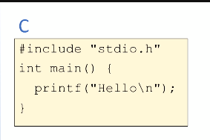
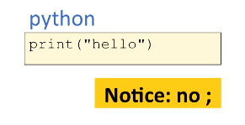
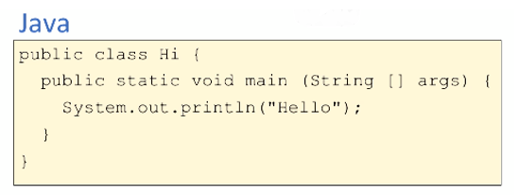
Python comparing with C

Slide 5
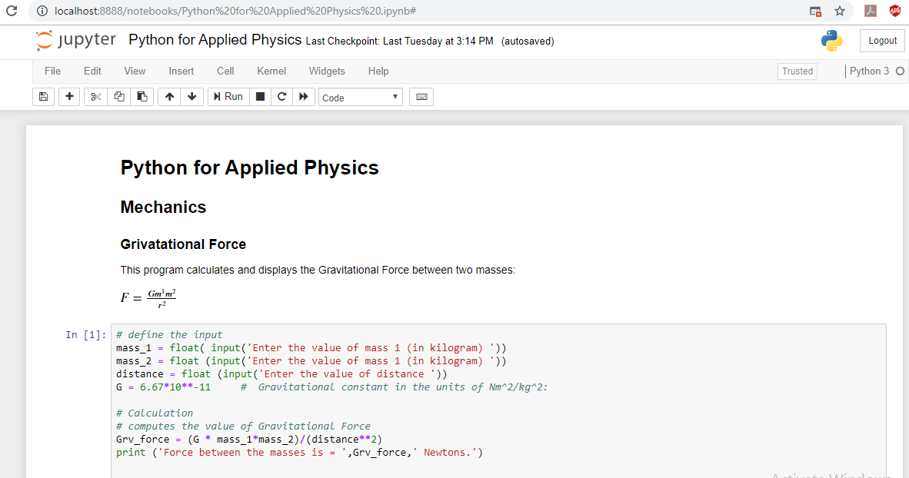

Slide 6
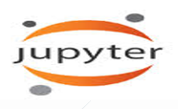
Introduction to Jupiter Notebook
The Jupyter Notebook is an open-source web application that allows us to create and share documents that contain live code, equations, visualizations and narrative text. Uses include: data cleaning and transformation, numerical simulation, statistical modeling, data visualization, machine learning, and much more.
A single document that combines explanations with executable code and its output — an ideal way to provide:
reproducible research results
documentation of processes
instructions
tutorials and training materials of all shapes and sizes

Slide 7
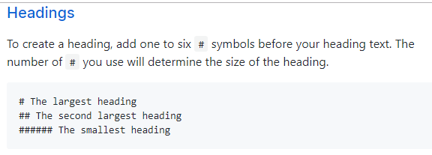
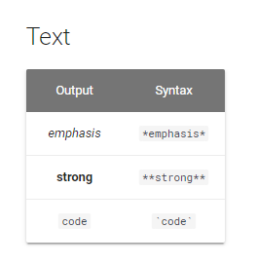
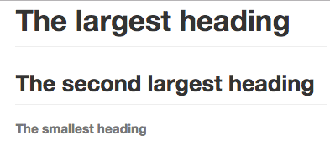
Markdown

Slide 8
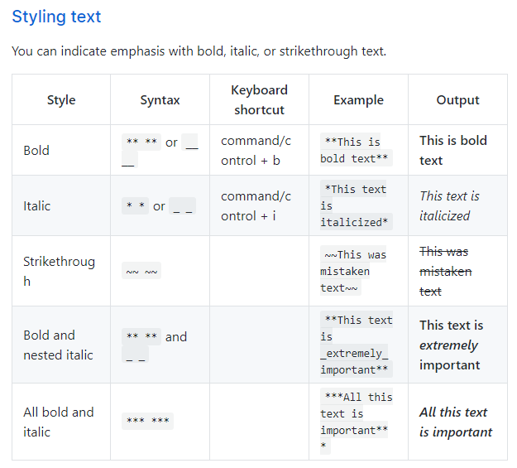

Slide 9
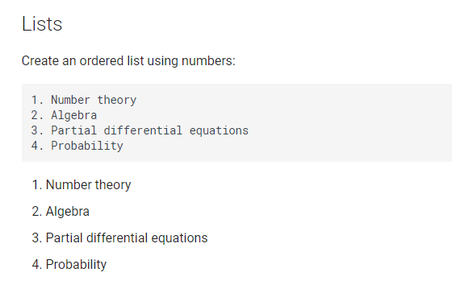
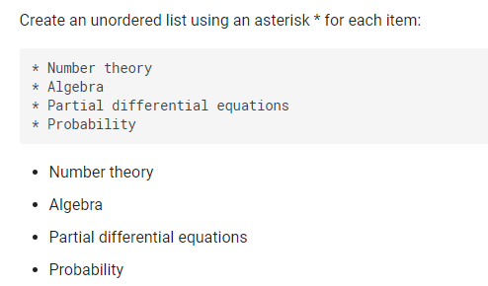

Slide 10
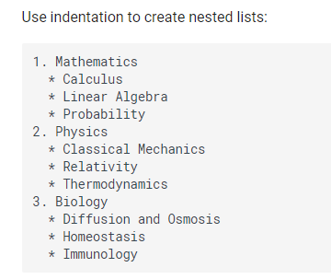
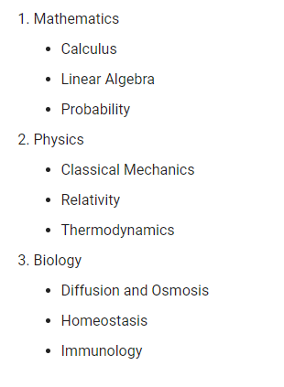

Slide 11
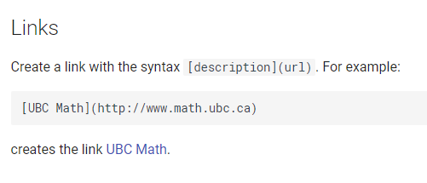
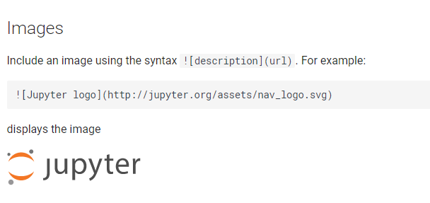

Slide 12
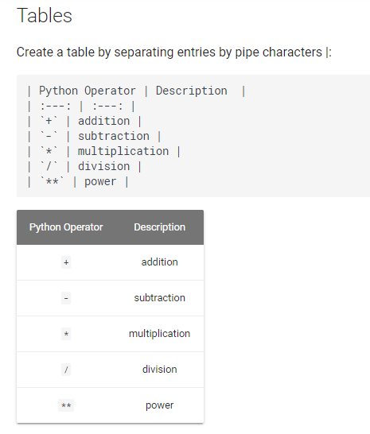

Slide 13
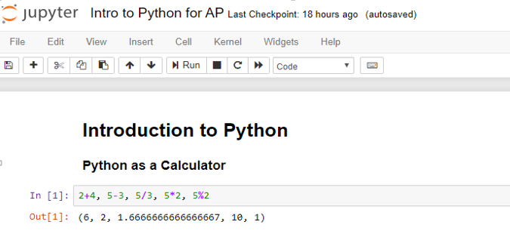
Introduction to Python

Slide 14
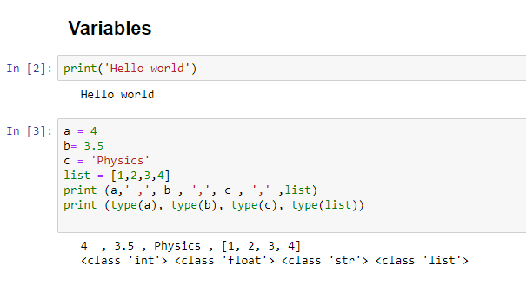

Slide 15
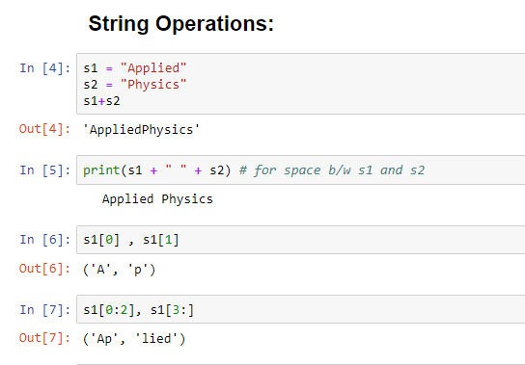

Slide 16
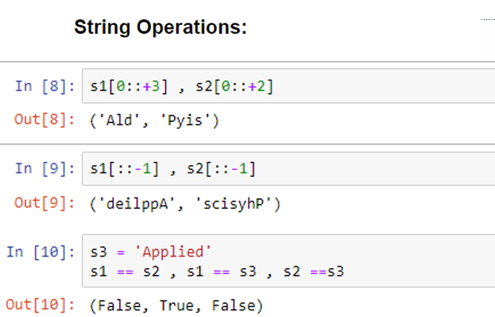

Slide 17
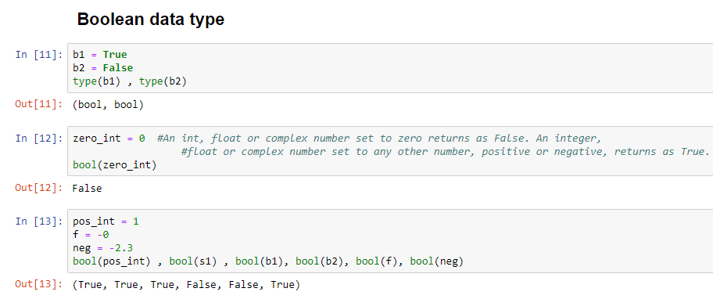

Slide 18
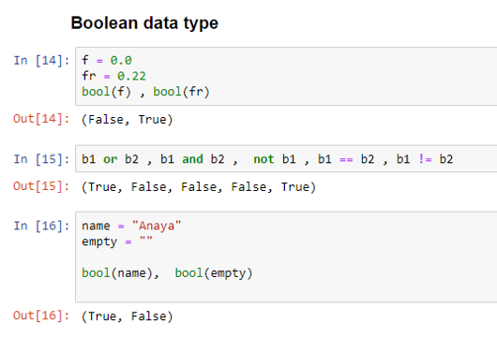

Slide 19
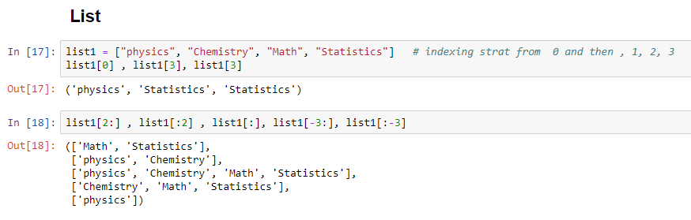
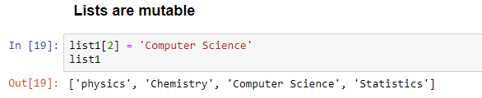

Slide 20
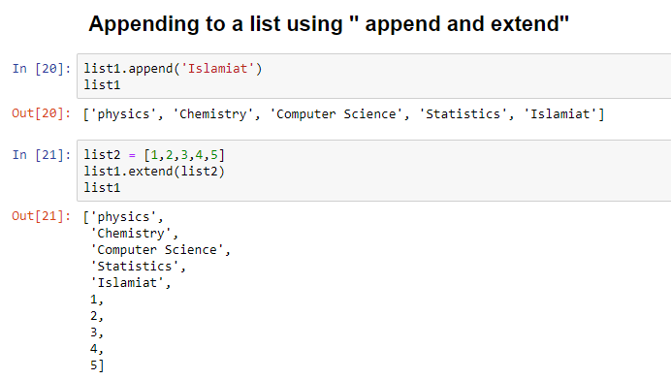

Slide 21
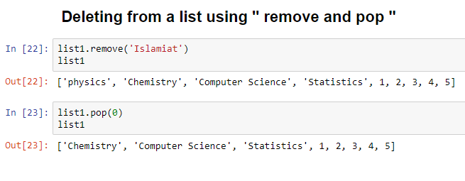
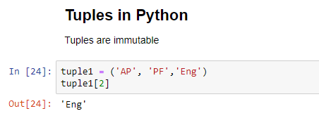

Slide 22
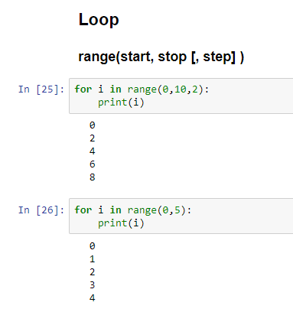
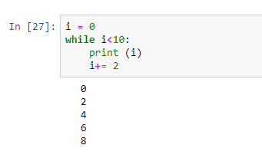

Slide 23
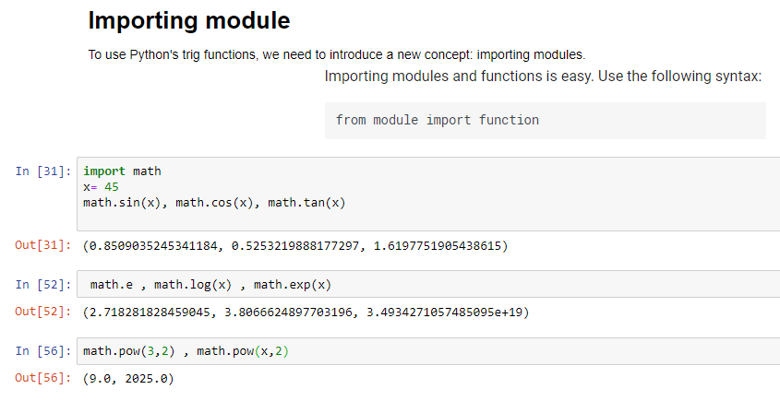


Slide 24
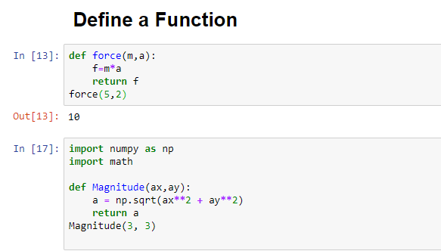

Slide 25
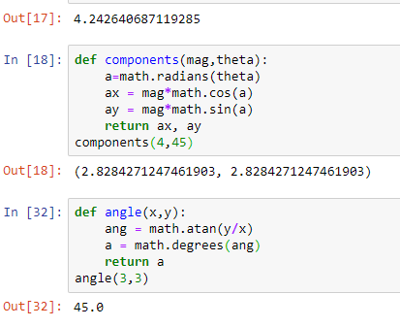

Slide 26
Numerical Python, or "Numpy“
Numerical Python, or "Numpy" for short, is a foundational package on which many of the most common data science packages are built. Numpy provides us with high performance multi-dimensional arrays which we can use as vectors or matrices.
The key features of numpy are:
ndarrays: n-dimensional arrays of the same data type which are fast and space-efficient. There are a number of built-in methods for ndarrays which allow for rapid processing of data without using loops (e.g., compute the mean).
Broadcasting: a useful tool which defines implicit behavior between multi-dimensional arrays of different sizes.
Vectorization: enables numeric operations on ndarrays.
Input/Output: simplifies reading and writing of data from/to file.

Slide 27
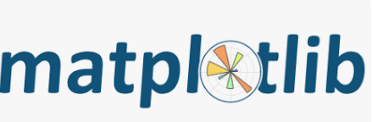
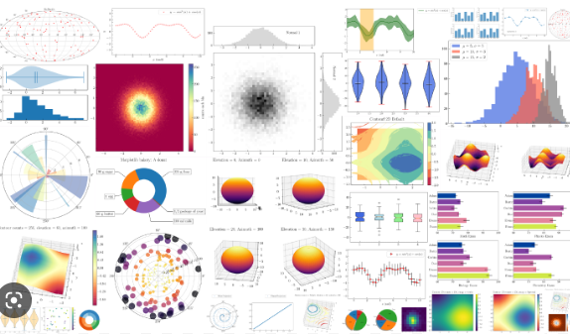
Exploring Data Visualization

Slide 28
Python for Physics

Slide 29
Vectors

Slide 30
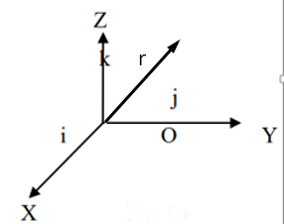




Vectors

Slide 31
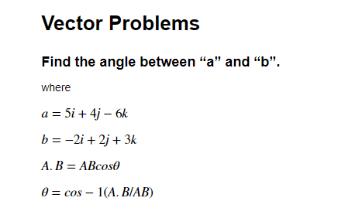
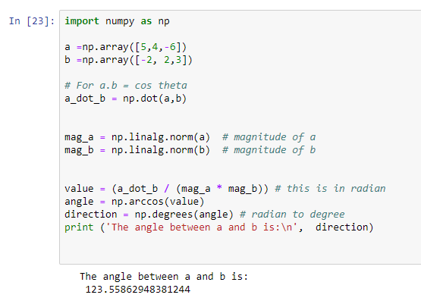

Slide 32
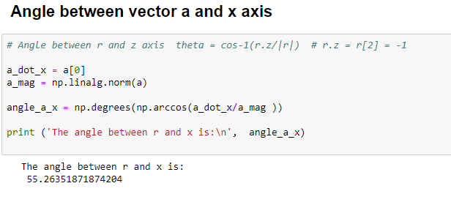

Slide 33
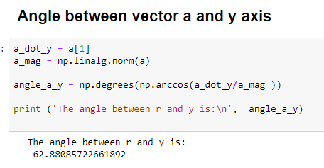

Slide 34
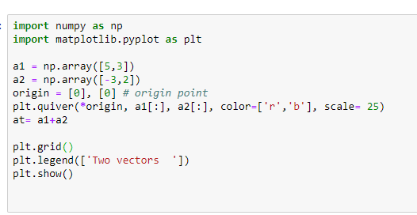
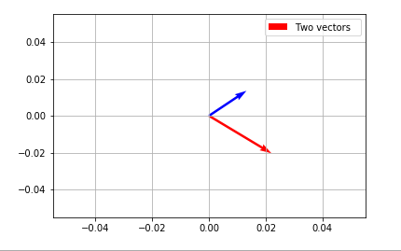
Draw Two vectors

Slide 35
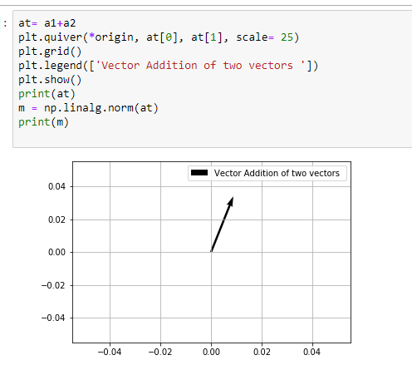

Resultant Vector

Slide 36
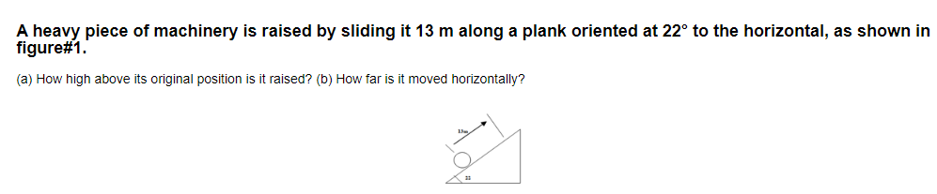
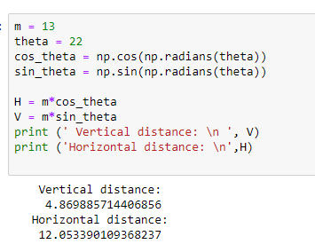
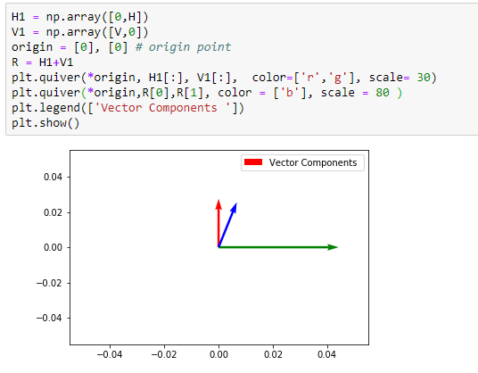

Slide 37
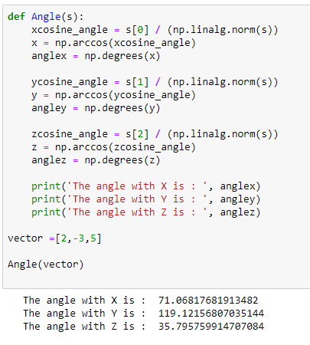
Function for finding angle from X, Y , and Z axes

Slide 38
Motion & Free Fall Motion

Slide 39
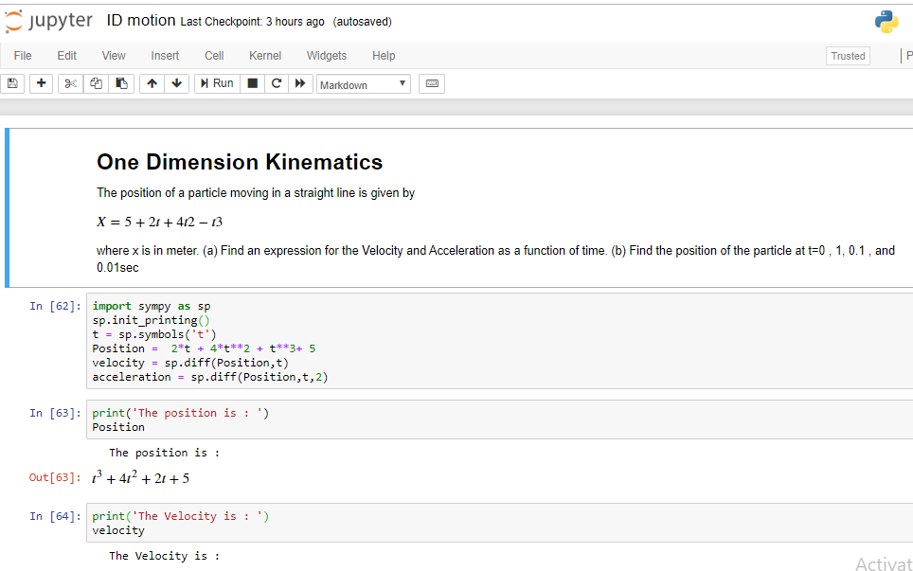

Slide 40
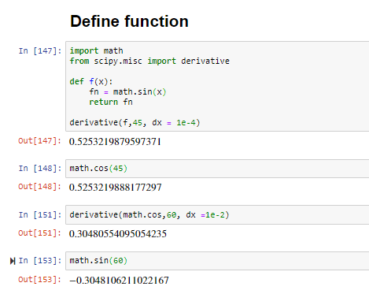

Slide 41
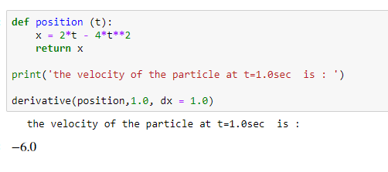

Slide 42





Slide 43
Projectile Motion

Slide 44



Slide 45


Slide 46


Slide 47


Slide 48



Slide 49


Slide 50


Slide 51
Waves and Oscillations

Slide 52



Slide 53



Slide 54



Slide 55



Slide 56


7

Slide 57



Slide 58



Slide 59


Slide 60



Slide 61



Slide 62



Slide 63
Gravitational Force

Slide 64


Slide 65


Slide 66




